Slide 1
Software Design Course (BSE 2210)
Unit 1.0: Introduction to Software Design
(Building a Strong Foundation in Software Design)
Presented by Jacob Chikwanda

Slide 2
Goals of this unit
Understand the Importance of Software Design.
Recognize how design impacts software quality, maintainability, and user satisfaction.
Familiarize with the Software Development Life Cycle (SDLC)
Gain an overview of the stages involved in developing software, from requirements gathering to maintenance.
Learn the Basic Software Design Process
Understand the steps involved in creating a well-structured software design, including requirement analysis and architectural planning.
Explore Different Software Design Methodologies
Discover various methodologies like Waterfall, Agile, and Scrum, and learn when to apply each one.

Slide 3
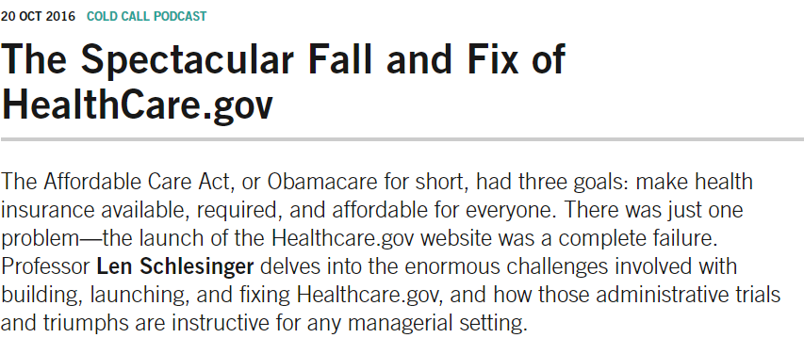
Is Software Design Worth Learning?
A case study worth studying - Obamacare

Slide 4
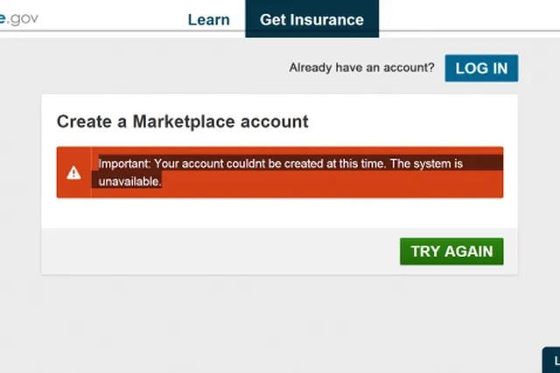
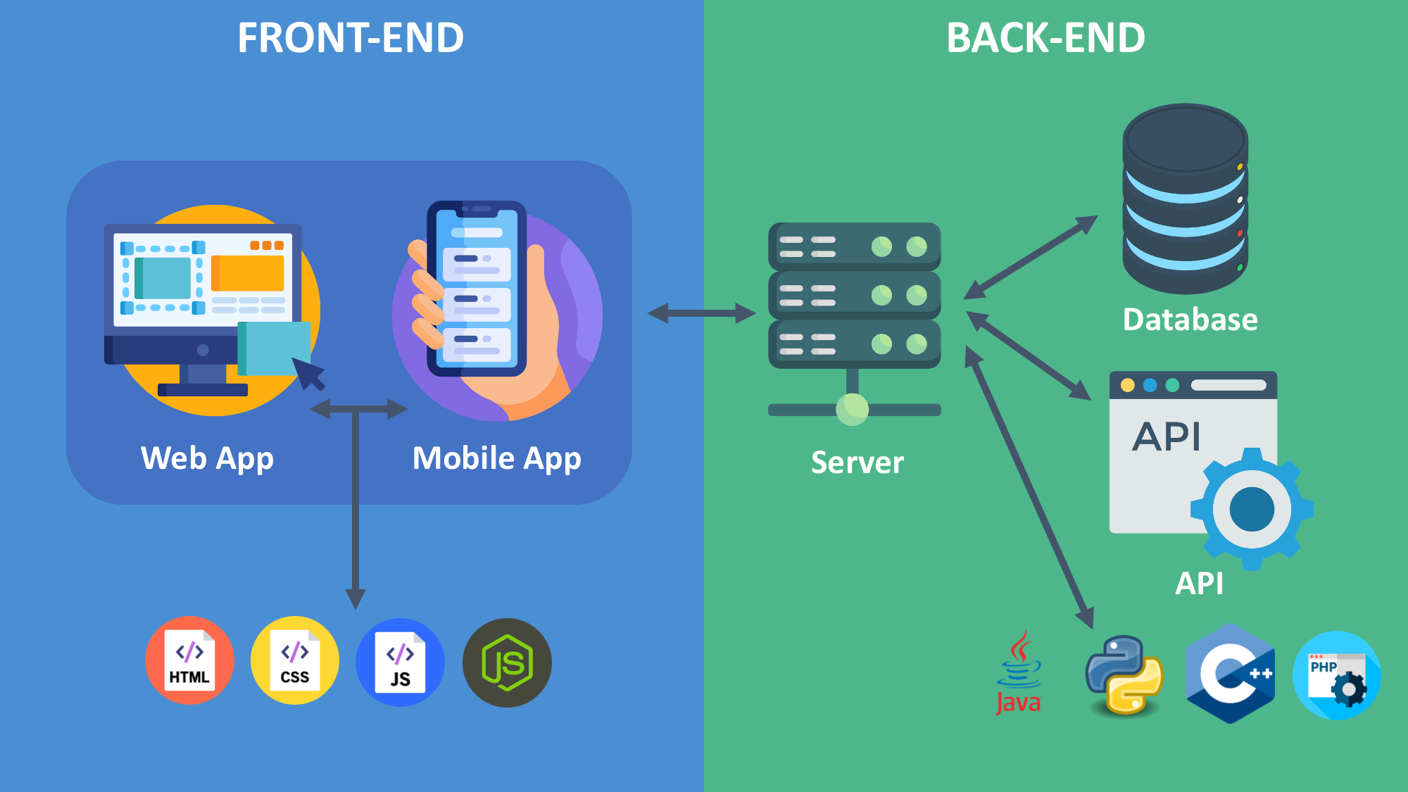
Is Software Design Worth Learning? Obamacare red flags
Technical Faliures
System Integration Problems
Bugs and Long delays
Not only frontend issues. Backend too!

Slide 5

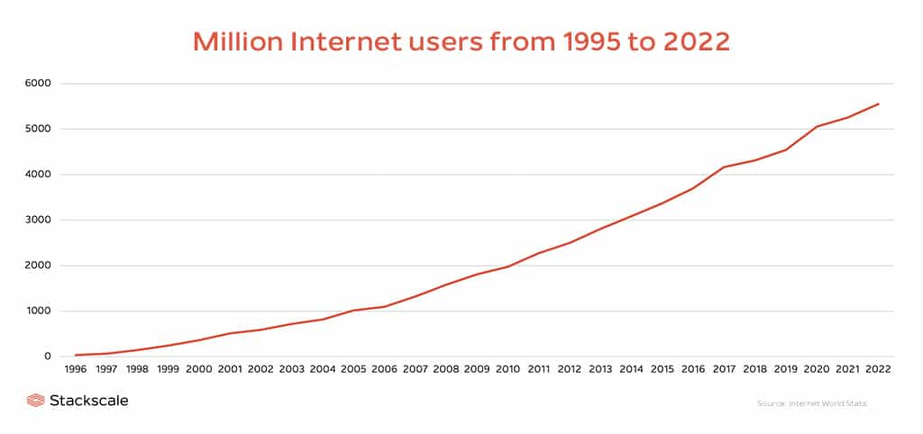
Is Software Design Worth Learning? Obamacare red flags
Warnings Ignored
Capacity Underestimation
User Registration & Usage

Slide 6
Research Assignment (20-30 minutes)
What is software design?
How does the Software Development Life Cycle (SDLC) relate to this problem?
What software development methodologies could have been used to tackle these issues, and how?
You are encouraged to find specific examples and explanations that relate to the Healthcare.gov case.

Slide 7
Good Day!

